Slide 1
Introduction to Big Data and AI
By Dr Shantanu Pathak
Ph.D Computer Engineering
Trainer and Consultant Since last 15+ years

Slide 2
Contents
Next few session we will discuss
1. Introduction to Big Data
2. Applications of Big Data
3. Introduction to Artificial Intelligence (AI)
4. Applications of Ai
5. Use of Ai in Big Data

Slide 3
Why Big Data ? Why AI? Why they are in Boom ?
Data (Authentic and Right Source)
Information
Decisions
Right Decision
Meaningful Progress

Slide 4
Introduction to Big Data

Slide 5
What’s Big Data?
What is Data?
The quantities, characters, or symbols on which operations are performed by a computer, which may be stored and transmitted
What is Big Data?
from Wikipedia:
Big data is primarily refers to data-sets that are too large or complex to be dealt with by traditional data-processing application software.
Challenges in Big Data
The challenges include capture, curation, storage, search, sharing, transfer, analysis, visualization and PURPOSEFUL FAKE data.

Slide 6
Why everyone is collecting LOT of data ?
1. More data -> better analytical power
This is understanding of a general public
2. Change in Sources of data
Traditional Sources : ONLY major companies, news papers, few websites
Current Data Sources
Every person
Every gadget
Every machine
Ex. Bank : account details, transactions, purchase history, photo, offers , loans, twitter sentiments, etc

Slide 7
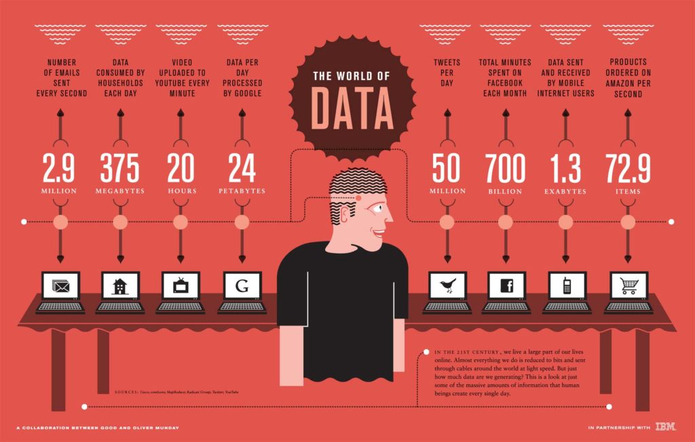
World of Data

Slide 8
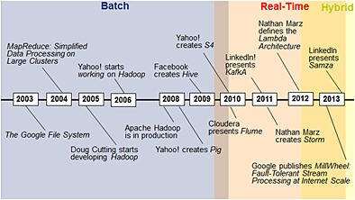
History of Big Data

Slide 9

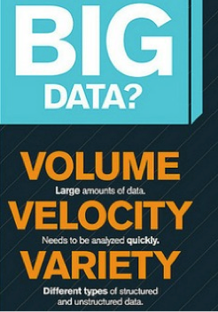
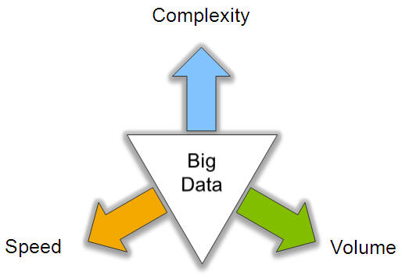
Big Data: 3V’s

Slide 10
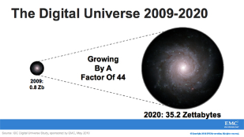
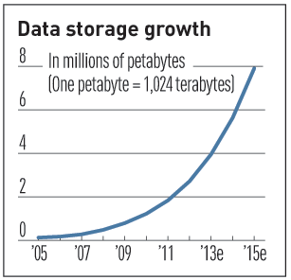

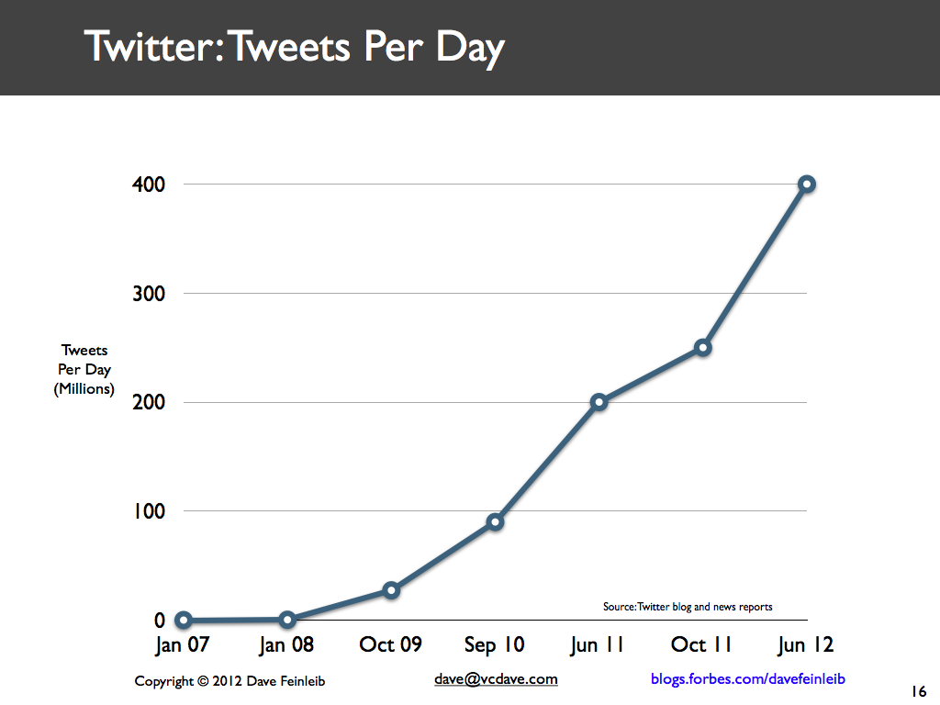
Volume (Scale)
Data Volume
44x increase from 2009 2020
From 0.8 zettabytes to 35zb
Data volume is increasing exponentially
Exponential increase in collected/generated data

Slide 11
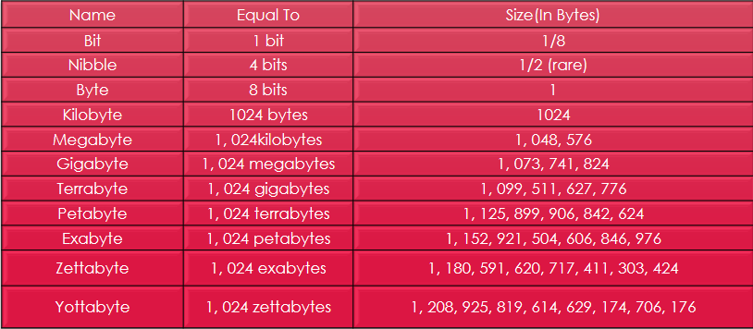
Size of data

Slide 12
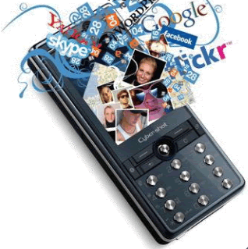


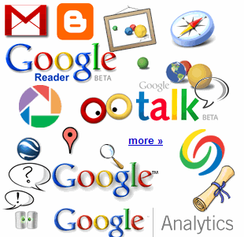

4.6 billion camera phones world wide
30 billion RFID tags today (1.3B in 2005)
12+ TBs of tweet data every day
100s of millions of GPS enabled devices sold annually
? TBs of data every day
25+ TBs of log data every day
2+ billion people on the Web by end 2011
76 million smart meters in 2009… 200M by 2014

Slide 13
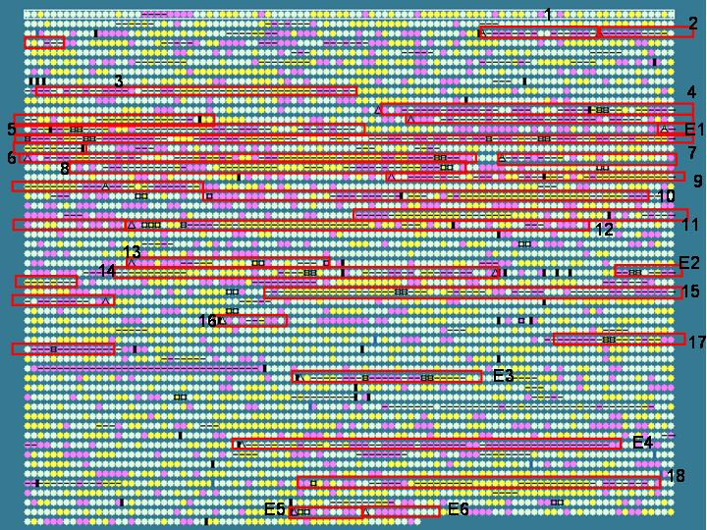
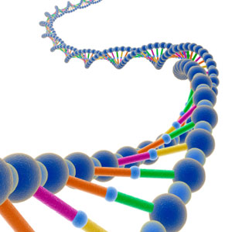
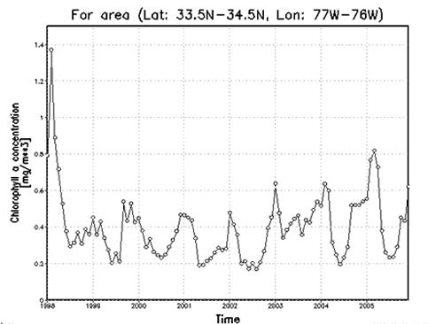

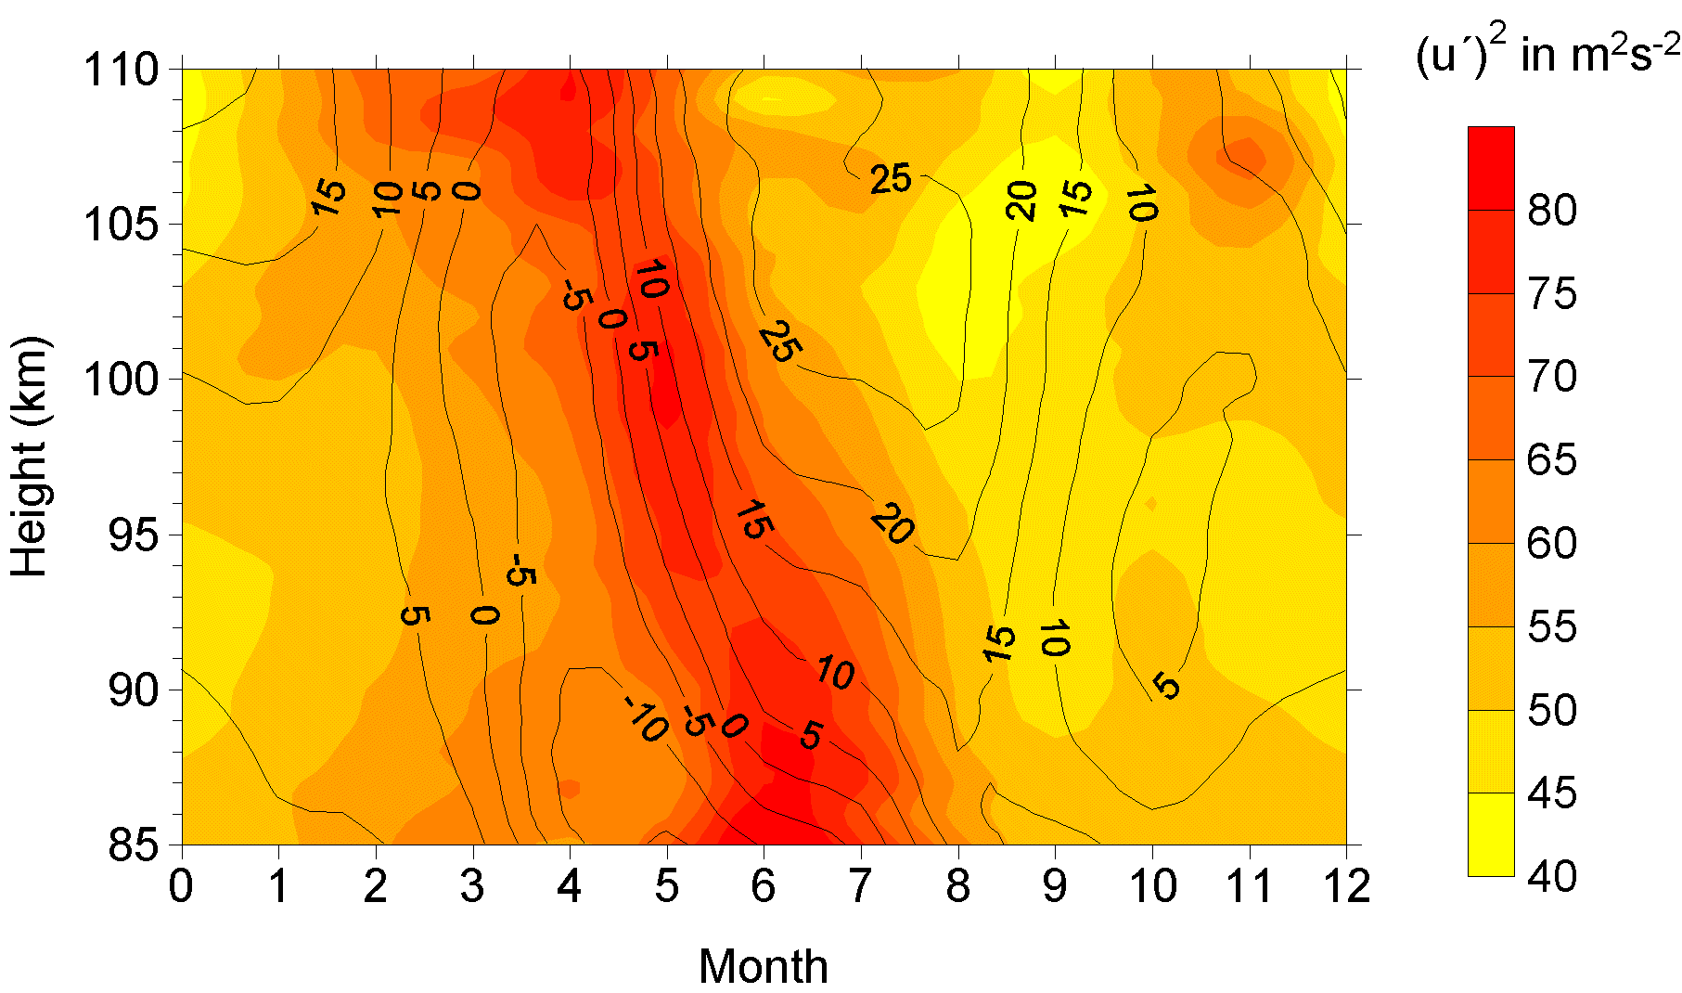
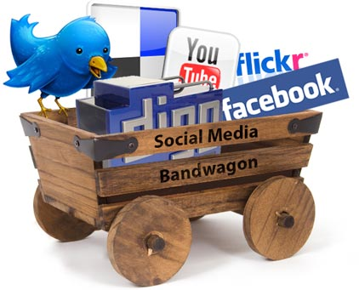
Variety (Complexity)
Relational Data (Tables/Transaction/Legacy Data)
Text Data (Web)
Semi-structured Data (XML)
Graph Data
Social Network, Semantic Web (RDF), …
Streaming Data
You can only scan the data once
A single application can be generating/collecting many types of data
Big Public Data (online, weather, finance, etc)
To extract knowledge➔ all these types of data need to linked together

Slide 14
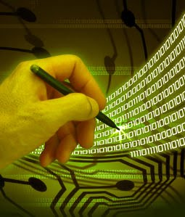
Velocity (Speed)
Data is begin generated fast and need to be processed fast
Online Data Analytics
Late decisions ➔ missing opportunities
Examples
E-Promotions: Based on your current location, your purchase history, what you like ➔ send promotions right now for store next to you
Healthcare monitoring: sensors monitoring your activities and body ➔ any abnormal measurements require immediate reaction

Slide 15
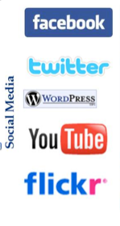
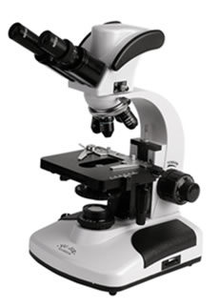

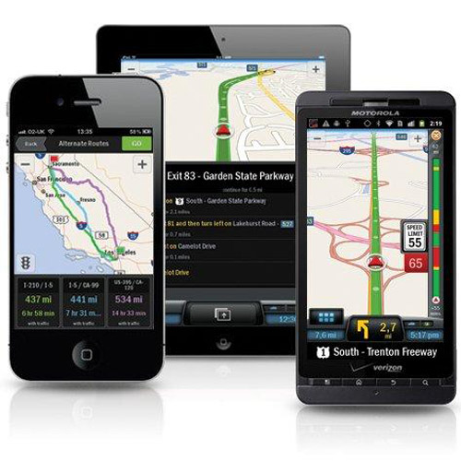

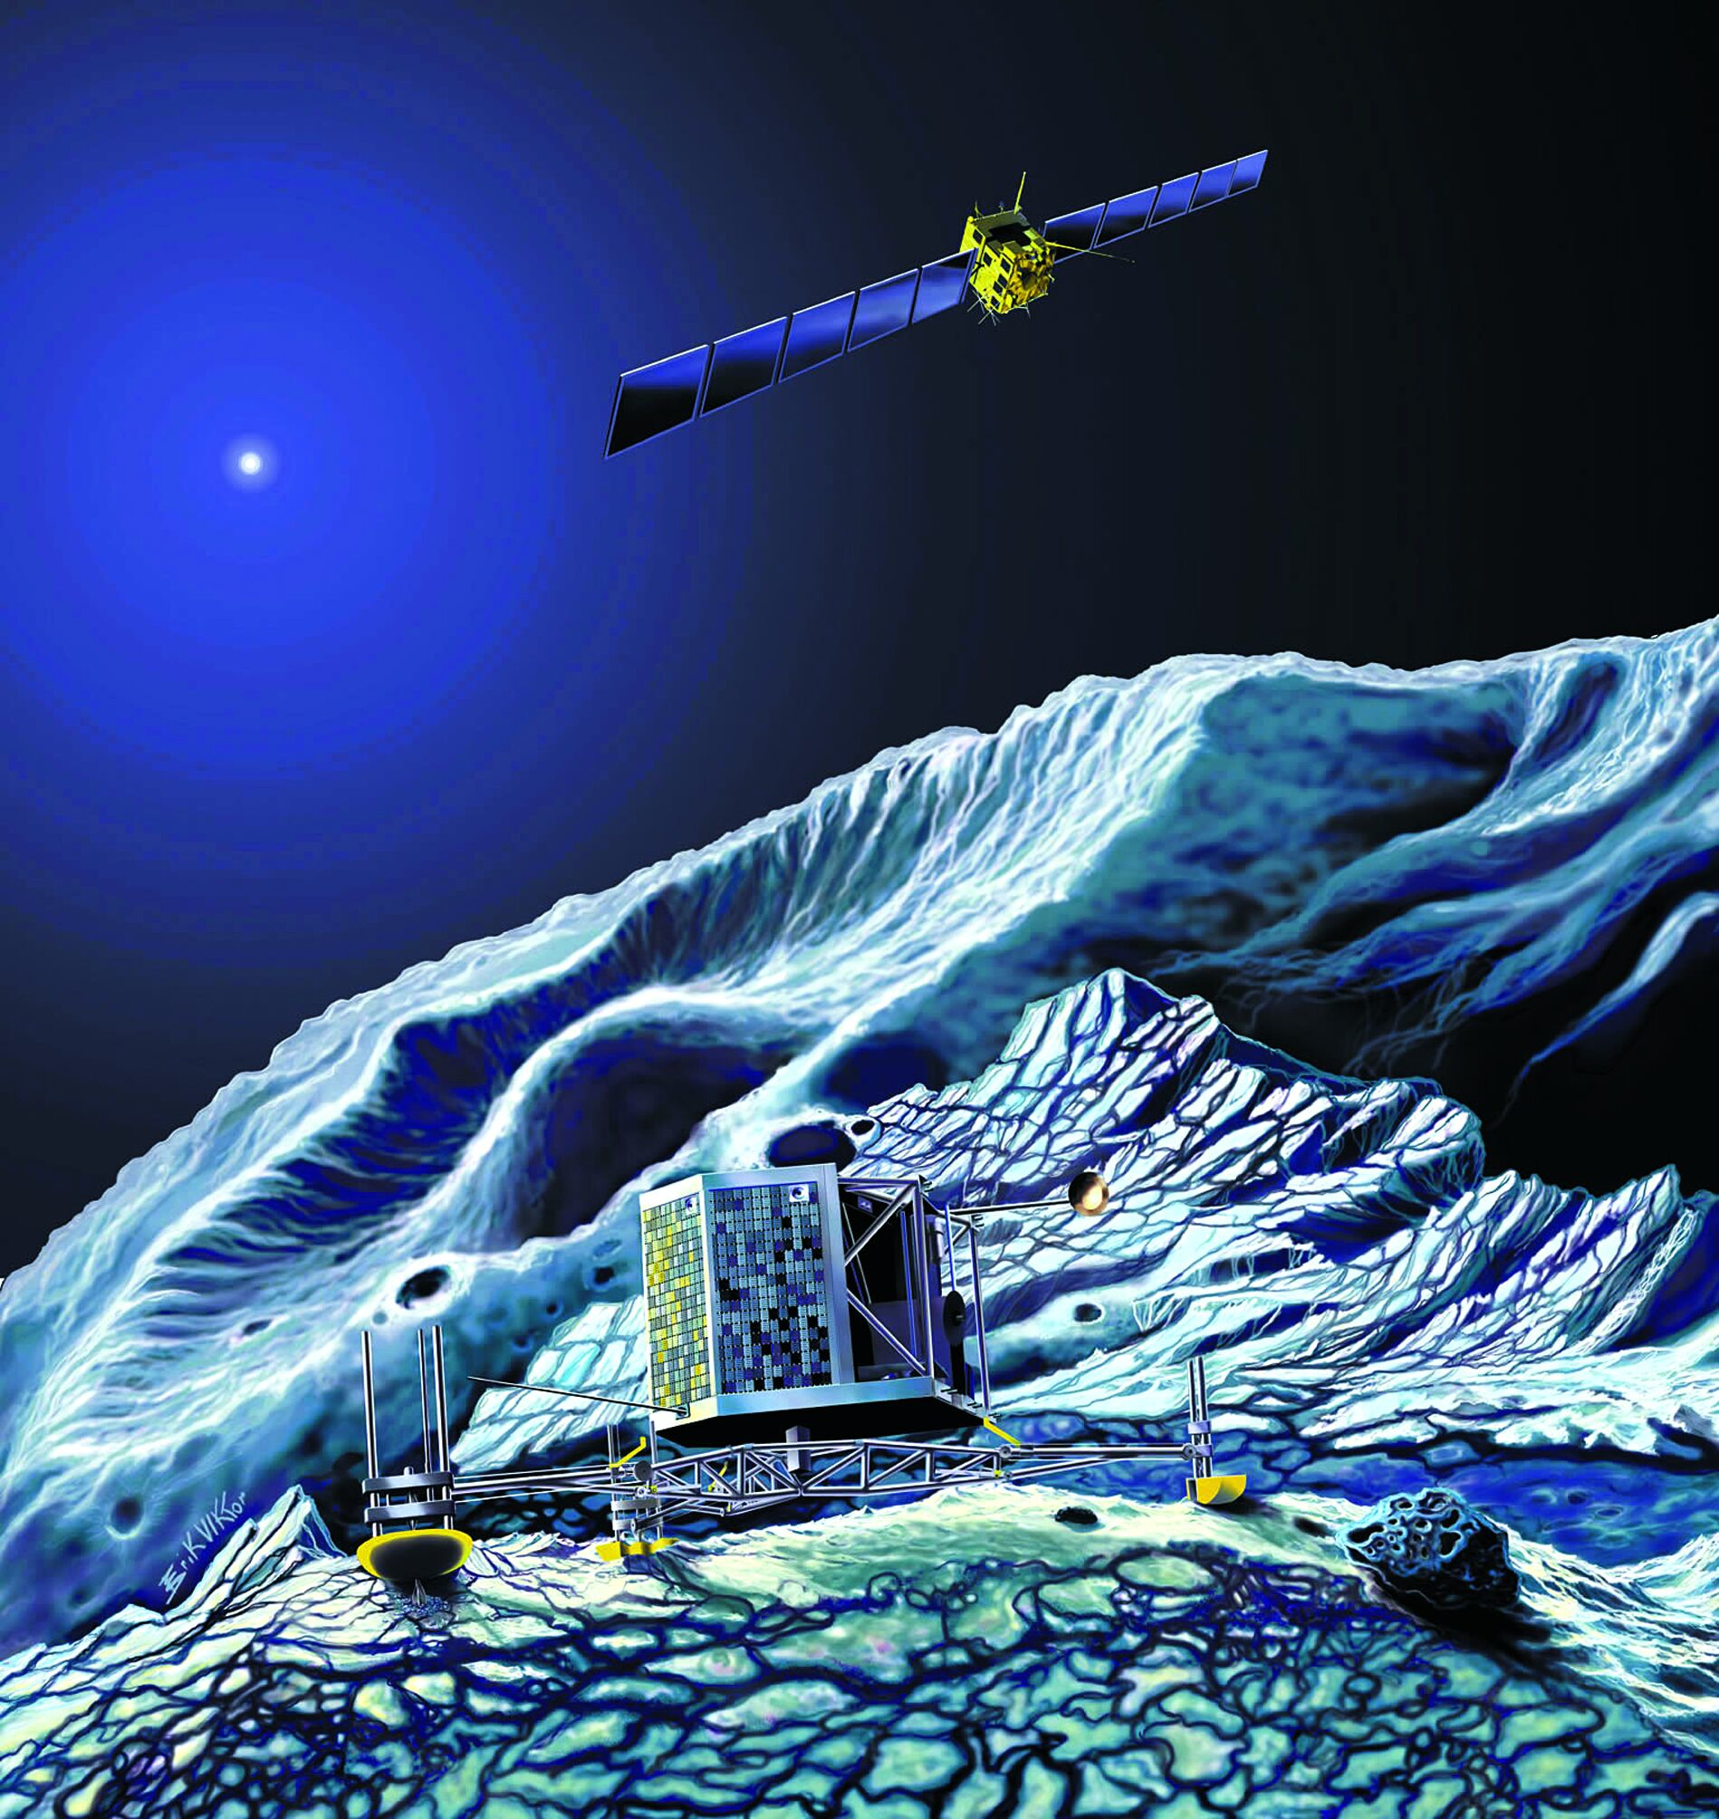
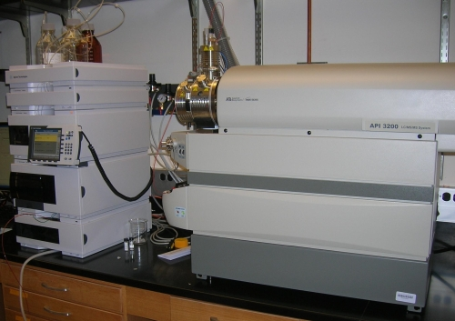
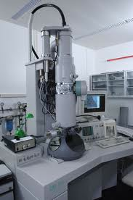
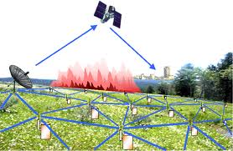

Real-time/Fast Data
Mobile devices
(tracking all objects all the time)
Social media and networks
(all of us are generating data)
Scientific instruments
(collecting all sorts of data)
Sensor technology and networks
(measuring all kinds of data)
The progress and innovation is no longer hindered by the ability to collect data
But, by the ability to manage, analyze, summarize, visualize, and discover knowledge from the collected data in a timely manner and in a scalable fashion

Slide 16

Real-Time Analytics/Decision Requirement
Product
Recommendations
that are Relevant
& Compelling
Learning why Customers
Switch to competitors
and their offers; in
time to Counter
Influence
Behavior
Customer
Friend Invitations
to join a
Game or Activity
that expands
business
Improving the
Marketing
Effectiveness of a
Promotion while it
is still in Play
Preventing Fraud
as it is Occurring
& preventing more
proactively

Slide 17
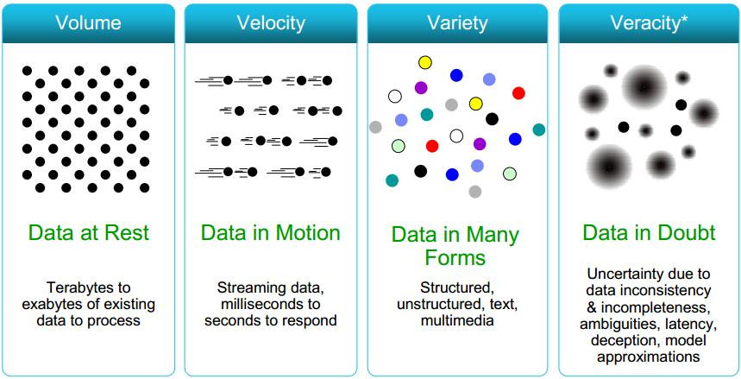
Some Make it 4V’s

Slide 18
How many V’s in Big Data ?
Some say 3
Some say 4
Wikipedia Says 6
Volume
Variety
Velocity
Veracity
Value
Variability
Ref: https://en.wikipedia.org/wiki/Big_data

Slide 19
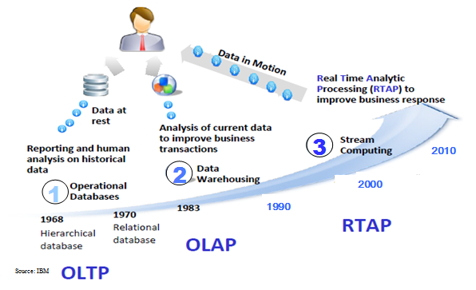
Harnessing Big Data
OLTP: Online Transaction Processing (DBMSs)
OLAP: Online Analytical Processing (Data Warehousing)
RTAP: Real-Time Analytics Processing (Big Data Architecture & technology)

Slide 20
Big Data based Jobs
Heavily Programming based
Full stack developers
Cloud Developers
Data Engineers
Security based
Data Security
Network security
Cloud Security
Analytics Based
Big Data Analytics
Machine Learning
Deep Learning
Business Intelligence
Person with Quality in Skills

Slide 21
Types of Digital data
1. Structured
2. Unstructured
3. Semi-structured

Slide 22
Structured Data
Any data that can be stored, accessed and processed in the form of fixed format is termed as a 'structured' data.
Ex. Excel sheets, Data in Tables, etc
Lot of storage tools support structured data storage
Excel
Data Bases SQL , MySQL , etc
Analytical tools support structured data analysis
Excel
Tablau
Power BI
PROBLEM :::
Now days size range of multiple zettabytes. (10^ 21 bytes)
Web data / Social media data cannot be in fixed structure

Slide 23
Unstructured data
Any data with unknown form or the structure is classified as unstructured data.
Example
Text files,
Images,
Videos
Social media post, etc.
Un-structured data Challenges
Storage
Processing and Extracting meaningful information
Size
Only having lot of data is not enough!

Slide 24
Semi- Structured Data
Can contain both the forms of data.
Some Structure and some part is Raw
Example
XML file
HTML Files

Slide 25
Need of Big Data Tools
For Unstructured and Semi structured data,
there is need of different types of storage and processing

Slide 26
Big Data Tools
Hadoop -> Storage file system and framework to process data fast
Uses HDFS -> Hadoop Distributed File System
Spark -> Storage and 10x processing compared to Hadoop
Storm -> to process data stream ( like CCTV footage analysis)
Hive -> Data Warehouse over Hadoop and SQL like processing
Kafka -> Data even Stream platform for pipelining
Flume -> for efficiently collecting, aggregating, and moving large amounts of log data
HBase -> NoSQL data on Hadoop. Supports stores versions of the data

Slide 27
Big Data Storage
Data Base
Structured data only
Insert delete update
ACID property
SQL only
Data Warehouse
Structured + un-structured
Insert delete update
ACID properties
Fixed languages for processing
Data Lake
Raw data ( structured / un-structured )
Can’t modify ( insert / delete / update), read ONLY
Any language for processing
Delta Lake ( introduced by Databricks )
DW + DL
Raw data ( structured / un-structured )
insert , delete , update possible
ACID properties
Any language for processing

Slide 28
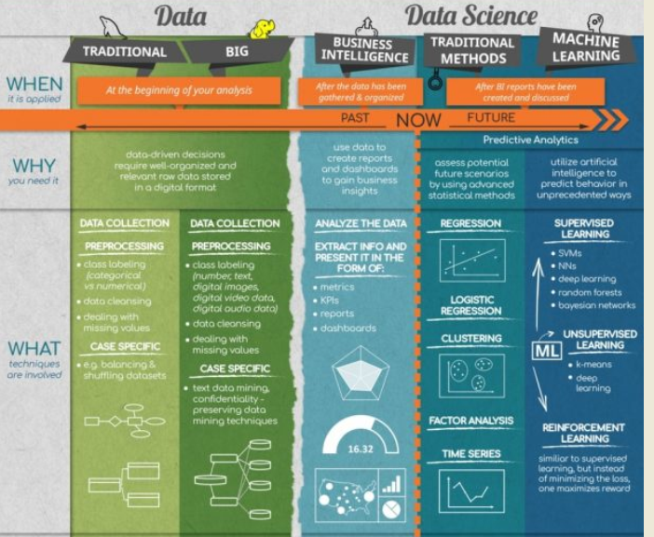

Slide 29
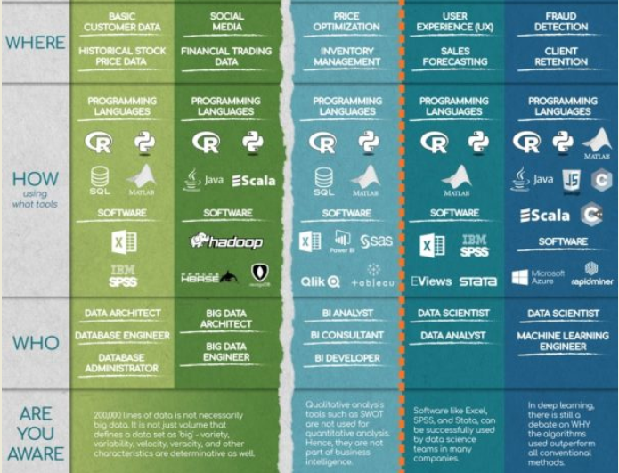

Slide 30
The Evolution of Business Intelligence
Interactive Business Intelligence &
In-memory RDBMS
QliqView, Tableau, HANA
Big Data:
Real Time &
Single View
Graph Databases
Speed
Scale
BI Reporting
OLAP &
Dataware house
Business Objects, SAS, Informatica, Cognos other SQL Reporting Tools
Big Data:
Batch Processing &
Distributed Data Store
Hadoop/Spark; HBase/Cassandra
Scale
Speed
1990’s
2000’s
2010’s

Slide 32
Big Data applications
Big Data in Healthcare
Big Data in Education
Big Data in E-commerce
Big Data in Media and Entertainment
Big Data in Finance
Big Data in Travel Industry
Big Data in Telecom
Big Data in Automobile
Almost Everywhere

Slide 33
Real Life Applications of Big data
How does a bank detect irregular activity ?
How does Gmap finds the traffic jam ?
How does Alexa helps facebook in friend suggestions ?
How does Gmap helps Croma stores ?
How does agriculture based insurance company find the fraud ?

Slide 34
Big Data in Retail
Check how Big Data act as a weapon for retailers to connect with their customers
Customer data generated is used for pattern analysis
Sales analysis
Marketing Analysis
Profit from Ads analysis
–Big Data in Retail.
Data from
various sources such as
social media,
loyalty programs, etc.

Slide 35
Programming Languages for Big Data
Environment for Big Data
Linux Operating System
Cloud Environment
Programming Languages
SQL -> Structured Query language
Python -> used for simple programming as well as programming for pySpark
JAVA -> Used for Object Oriented programming and Huge projects
SCALA -> used for Spark based Softwares

